Slide 1
The Relationship Between Preferred Sleep Position, Heart Rate, Arterial Blood Pressure, Respiratory Rate and Peripheral Oxygen Saturation
Stj. Dr. İlke Soylu
Prof. Dr. İsmail Meral

Slide 2
Aim of the Study
Sleep is the unconscious phase that a person can be awakened by stimulus. Sleeping position is crucial for falling asleep and maintaining a quality sleep.
Studies have been conducted to determine preferences for sleeping positions for specific groups of people, and certain positions were preferred more often.
However, such a study was not conducted in the young adult group, which will be our subject of research.

Slide 3
Aim of the Study
The aim of this study is to investigate the relationship between the preferred sleep position and parameters such as heart rhythm, arterial blood pressure, respiratory rate and peripheral oxygen saturation in students aged 18-23.
Our research hypothesis: Do individuals unconsciously determine their sleep position according to the parameters of heart rhythm, arterial blood pressure, respiratory rate and peripheral oxygen saturation?

Slide 4
Method
In order to find a statistically significant and meaningful results, it was calculated that at least 30 participants should be observed.
The study included 30 female and 30 male students. A consent form was read and signed by each of the participants to provide information about the study and to obtain their consent that they participated voluntarily.
Participants' required informations were recorded with a questionnaire containing seven questions, and a guide containing visuals of the sleeping positions was also given during the survey in order to understand the questionnaire correctly.

Slide 5
Method
The students participating in the study were placed, in supine, prone, starfish, right lateral decubitus, left lateral decubitus and fetal sleeping position in the same order. Measurements were made at the end of a 5-minute adaptation period following each sleeping position.
Heart rate and arterial blood pressure were determined with an electronic blood pressure meter, peripheral oxygen saturation with a finger-type pulse oximeter, and respiratory rate by observing.
Inclusion Criteria
18-23 y.o.
Exclusion Criteria
BMI value < 20 or > 25
Statistical Analysis
Mean and standard deviation are presented as descriptive statistics. ANOVA tests were used to compare the positions and analyzes were made with IBM SPSS 20.0 program. The significance level was accepted as 0.05.
BMI value between 20-25
Use of a max. 1 pack (20 pieces) of cigarettes per day
Absence of a chronic or acute illness
Use of more than 1 pack of cigarettes per day
Having any chronic or acute illness

Slide 6
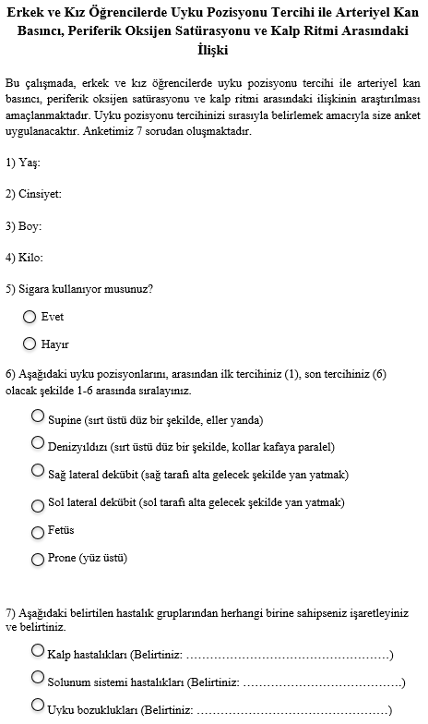
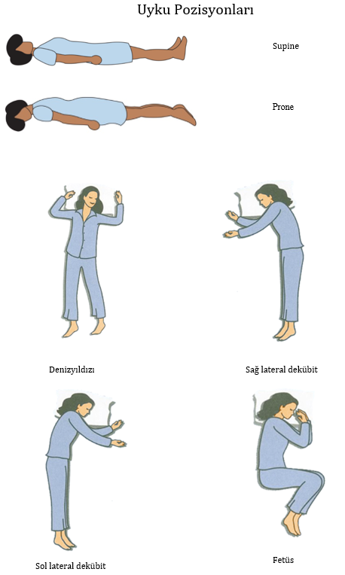

Slide 7
Results
It was found that the pulse and respiratory rate were not related to the position (p>0.05).
It was found that systolic arterial pressure (p=0.01), diastolic arterial pressure (p=0.02), and oxygen saturation (p=0.007) were significantly affected by position.
The highest oxygen saturation was found in the prone position and the lowest in the supine position.
The highest systolic arterial pressure was in the supine position and the lowest was in the right lateral decubitus position. The highest diastolic arterial pressure was in the supine position and the lowest was in the right lateral decubitus position.

Slide 8
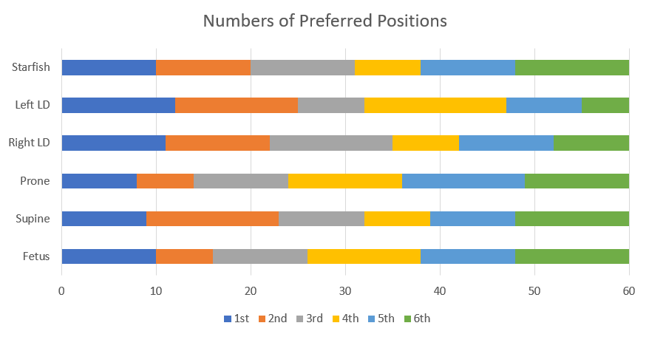
Results
Preference frequency of sleeping positions

Slide 9
Results
As a result of the measurements made for 60 participants, the following table was created by taking the average of the values found for the 5 vital values in each sleep position.

Slide 10
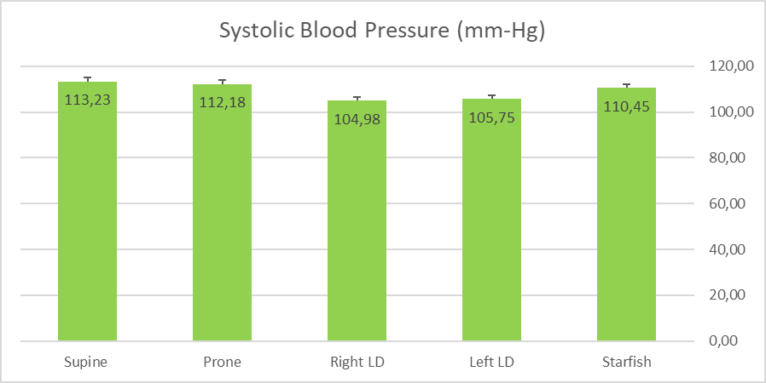
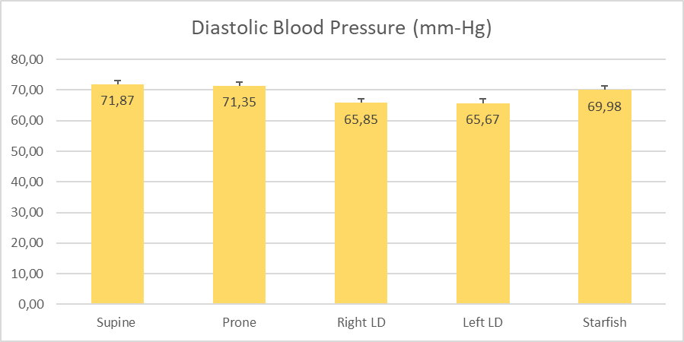
Results
The graphs of the averages table created in the previous step, together with the standard error bars of the measurements, were created. While making a comparison between sleep positions at this step, no acceptable difference was found in the values of pulse, O2 saturation and respiratory rate, but an acceptable difference was found in the values of systolic and diastolic blood pressure.

Slide 11
Conclusion
As a result of the tests performed, it was found that the distribution of systolic, diastolic arterial pressure, and oxygen saturation were affected from positions. Therefore, the distribution of pulse and respiratory rate values was found to be the same across all positions.

Slide 12
References
Guyton ve Hall Tıbbi Fizyoloji. Elsevier. 2013. 12.basım. Beyin Etkinlik Durumları-Uyku, Beyin Dalgaları, Epilepsi, Psikozlar. John E. Hall, PhD, Arthur C. Guyton et al.
Better Sleep Council | Start every day with a good night’s sleep. (2019). Sleep Positions. [online] Available at: https://bettersleep.org/better-sleep/sleep-positions/ [Accessed 6 Dec. 2019].
Galland BC, Taylor BJ, Bolton DPG. Prone versus supine sleep position: a review of the physiological studies in SIDS research [Internet]. Journal of paediatrics and child health. U.S. National Library of Medicine; 2002 [cited 2019Dec6]. Available from: https://www.ncbi.nlm.nih.gov/pubmed/12173990
Shepherd KL, Yiallourou SR, Odoi A, Yeomans E, Willis S, Horne RSC, et al. When does prone sleeping improve cardiorespiratory status in preterm infants in the NICU? [Internet]. Sleep. U.S. National Library of Medicine; 2019 [cited 2019Dec6]. Available from: https://www.ncbi.nlm.nih.gov/pubmed/31691829
Galland BC, Reeves G, Taylor BJ, Bolton DP. Sleep position, autonomic function, and arousal [Internet]. Archives of disease in childhood. Fetal and neonatal edition. BMJ Group; 1998 [cited 2019Dec6]. Available from: https://www.ncbi.nlm.nih.gov/pubmed/9713030
Leung RST, Bowman ME, Parker JD, Newton GE, Bradley TD. Avoidance of the left lateral decubitus position during sleep in patients with heart failure: relationship to cardiac size and function [Internet]. Journal of the American College of Cardiology. U.S. National Library of Medicine; 2003 [cited 2019Dec6]. Available from: https://www.ncbi.nlm.nih.gov/pubmed/12535814
van Maanen JP, Meester KAW, Dun LN, Koutsourelakis I, Witte BI, Laman DM, et al. The sleep position trainer: a new treatment for positional obstructive sleep apnoea [Internet]. Sleep & breathing = Schlaf & Atmung. U.S. National Library of Medicine; 2013 [cited 2019Dec6]. Available from: https://www.ncbi.nlm.nih.gov/pubmed/22927107
Cartwright, D. R, Diaz, Stephen, Lloyd. Effects of Sleep Posture and Sleep Stage on Apnea Frequency [Internet]. OUP Academic. Oxford University Press; 1991 [cited 2019Dec6]. Available from: https://academic.oup.com/sleep/article/ 14/4/351/2742835

Slide 13
Thank you for listening
Q&A

